Slide 1
Automatic Indexing

Slide 2
Classes of Automatic Indexing
Automatic indexing is the process of analyzing an item to extract the information to be permanently kept in index.
This process is closely linked to creating searchable data structures that represent the item.

Slide 3
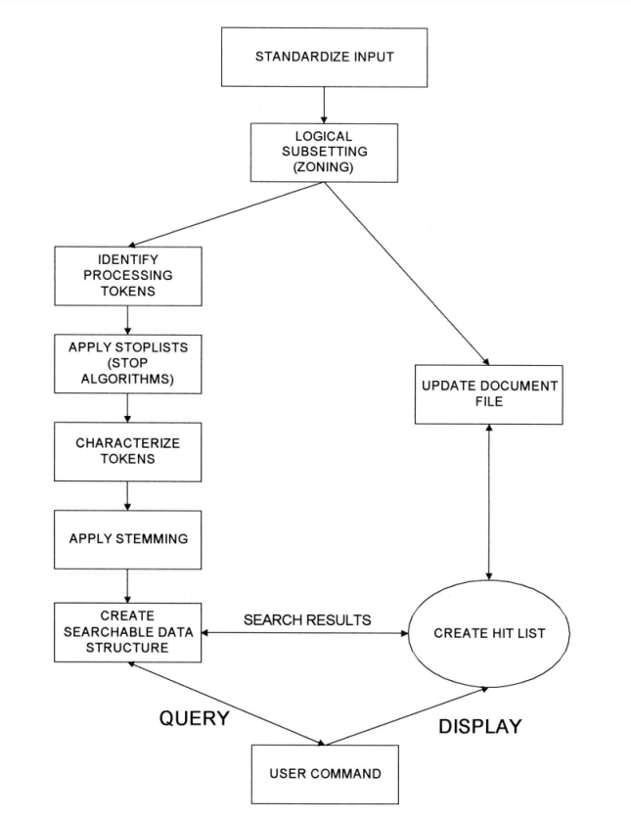
Classes of Automatic Indexing
The left side of the figure including Identify Processing Tokens, Apply Stop Lists, Characterize tokens, Apply Stemming and Create Searchable Data Structure is all part of the indexing process

Slide 4
Classes of Automatic Indexing
The indexing process begins with zoning the document, which divides it into manageable sections.
This is followed by identifying processing tokens—key elements that will be indexed.
To refine these tokens, filters like stop lists (which eliminate common, uninformative words) and stemming algorithms (which reduce words to their base forms) are applied.

Slide 5
Classes of Automatic Indexing
After token refinement, the system’s search strategy determines how to utilize the index.
Search strategies fall into three main categories:
  statistical,
  natural language, and
  concept-based.
Ultimately, the index itself is a data structure designed to support these strategies, enabling efficient retrieval of information based on user queries.

Slide 6
Classes of Automatic Indexing
Statistical strategy - covers the broadest range of indexing techniques and common in commercial systems .
These strategies are based on the frequency of occurrence of events, particularly the processing tokens (words or phrases) found in documents and databases.
These tokens serve as the domain of searchable values.

Slide 7
Classes of Automatic Indexing
Various statistical methods are applied to this event data, including probabilistic, Bayesian, vector space, and neural network approaches:
  Static Approach: This method records basic statistics, such as the frequency of each word in an item, which helps generate relevance scores following a standard Boolean search.
  Probabilistic Indexing: This technique calculates the probability that a specific item is relevant to a given query by storing relevant statistical information.
  Bayesian and vector space – The Bayesian and Vector Space approaches both gather and analyze information to evaluate how confident we can be about an item's relevance to a query.
  Neural Networks: These are dynamic learning structures that fall under concept indexing. They help identify concept classes and are particularly useful for understanding the relationships between terms and concepts in data.

Slide 8
Classes of Automatic Indexing
Natural Language approaches begin similarly to statistical techniques by identifying processing tokens, but they go further by incorporating natural language parsing.
  This parsing helps clarify the context of these tokens, allowing the system to understand nuances such as verb tenses (e.g., present, past, future) and to generalize to broader concepts.
Concept indexing uses the words within an item to correlate to concepts discussed in the index item.
When generating concept classes automatically, it’s possible that the resulting concepts do not have specific names associated with them; instead, they are defined solely by their statistical significance.
  This means that the system identifies and groups related terms based on their occurrence patterns and relationships within the data, rather than assigning traditional labels.

Slide 9
Classes of Automatic Indexing
Finally, a special class of indexing can be defined by creation of hypertext linkages.
  These linkages provide virtual threads (connection) of concepts between items versus directly defining the concept within an item.
Each indexing technique has its strengths and weaknesses.
Current evaluations from TREC conferences indicate that to achieve the best results in locating relevant items, it is beneficial to apply multiple algorithms to the same dataset.
However, this multi-algorithm approach comes with significant storage and processing overhead, making it essential to balance effectiveness with resource efficiency.

Slide 10
Statistical Indexing
Statistical indexing uses frequency of occurrence of events to calculate a number that is used to indicate the potential relevance of an item.
In some older systems, a simple Boolean search is used to find documents. Afterward, statistical methods (like term frequency) are applied to rank the found documents based on their relevance.
  This provided a relevance score that could be used to sort the results, improving the overall quality of the search output.
While effective, this two-step approach had limitations.
  The initial Boolean search could miss relevant documents, and the statistical ranking was not always optimal, as it did not take into account the broader context and relationships within the document corpus.

Slide 11
Statistical Indexing
Probabilistic retrieval models, such as the Bayesian approach, aim to assign a probability value to each document, indicating the likelihood of its relevance, to a given query.
This allows for a more accurate and nuanced (సూక్ష్మమైన / subtle and complex) ranking of search results, as the relevance probability takes into account the entire document corpus and search context.
  A probability of 50% means that, on average, half of the items reviewed will be relevant.

Slide 12
Statistical Indexing
A key challenge in probabilistic retrieval is merging results from multiple databases or search algorithms.
This issue is especially complex when different methods yield different relevance scores.
  if true probabilities were reliably calculated, merging results would be less problematic.

Slide 13
Statistical Indexing
---- Probabilistic Weighting
The probabilistic approach is based upon direct application of the theory of probability to information retrieval systems.
The principles and concepts derived from the probabilistic approach guide and shape how algorithms are designed and implemented in information retrieval systems.
A significant advantage is the ability to integrate results from different databases, as probability provides a consistent framework for evaluation.

Slide 14
Probabilistic Weighting
HYPOTHESIS: According to the Probability Ranking Principle, a retrieval system works best when it ranks documents in order of decreasing probability of usefulness to the user who submitted the request, where the probabilities are estimated as accurately as possible on the basis of whatever data is available to the user.
  Essentially, if you can accurately estimate how useful a document is, the system will perform better.
  Plausible Corollary (REASONABLE RESULT ): It suggests that standard probability theory and statistics offer the best tools for estimating these probabilities, leading to better ranking techniques.

Slide 15
Probabilistic Weighting
Traditional probabilistic models often consider relevance in a binary manner (relevant or not relevant). A more complex strategy recognizes that relevance is a continuum and that different weights can correspond to different levels of relevance.
The output ordering by rank of items based on probabilities, even if accurately calculated, may not be as optimal as that defined by some domain-specific heuristic.
  However, these cases are limited in scope and do not significantly undermine the overall efficacy of probabilistic methods.

Slide 16
Probabilistic Weighting
The source of the problems that arise in the application of probability theory comes from a lack of accurate data and simplifying assumptions made during model construction. These assumptions can lead to less precise results compared to other methods.
The probabilistic approach can accurately identify its weak assumptions and work to strengthen them, whereas the underlying weaknesses in other approaches are less obvious and harder to identify and correct.
  Despite some drawbacks, probabilistic methods remain competitive in performance evaluations, such as those conducted in the TREC conferences, even if they don’t always achieve the highest scores.

Slide 17
Probabilistic Weighting
There are many different areas in which the probabilistic approach may be applied.
One example of how a probabilistic technique is used for information retrieval is the logistic regression method.
The retrieval system starts with a "Model 0" (begins by collecting basic statistics about the query terms) system, which exists before specific probabilistic models are applied

Slide 18
Probabilistic Weighting
In a retrieval system there exist query terms q_{i} and document terms d_{i} which have a set of attributes (v₁….v_{n}) from the query (e.g., counts of term frequency in the query), from the document (e.g., counts of term frequency in the document ) and from the database (e.g., total number of documents in the database divided by the number of documents indexed by the term)
The logistic regression model uses a random sample of query-document-term triples for which binary relevance judgments have been made from a training sample to derive the coefficients for the logodds of relevance.

Slide 19
Probabilistic Weighting
query-document-term triples Example:
  Query: "climate change“
  Documents:
    Document A: "The impact of climate change on agriculture."
    Document B: "A study on renewable energy sources."
    Document C: "Climate change and its effects on wildlife."
    Document D: "Healthy recipes for a balanced diet.“
  Creating the Triples:
    Document A:
      Terms: "climate," "change"
      Relevance Judgment: 1 (Relevant)
      Triple: (Query: "climate change", Document: A, Term: "climate")
      Triple: (Query: "climate change", Document: A, Term: "change")
    Document B:
      Terms: "renewable," "energy"
      Relevance Judgment: 0 (Not Relevant)
      Triple: (Query: "climate change", Document: B, Term: "renewable") - Not applicable
      Triple: (Query: "climate change", Document: B, Term: "energy") - Not applicable
For Document B, no triples would be relevant as they do not contain the terms from the query.

Slide 20
Probabilistic Weighting
Odds: Odds represent the ratio of the probability of an event occurring to the probability of it not occurring.
If P is the probability of an event occurring, then the odds O can be calculated as:
  O=P/1−P
  ​Log odds is simply the natural logarithm (log) of the odds.
    Log O=log(P/1−P​) = C₀ + C₁V₁ + …… + C_{n}V_{n}

Slide 21

Probabilistic Weighting
Log O is the logarithm of the odds (logodds) of relevance for term t_{k} which is present in document D_{j} and query Q_{i}.
  log (O(R|Q_{i}, D_{j}, t_{k})) = C₀ + C₁V₁ + …… + C_{n}V_{n}
The logarithm that the i^{th} Query is relevant to the j^{th} Document is the sum of the logodds for all terms:
where O(R) is the odds that a document chosen at random from the database is relevant to query Q_{i} .

Slide 22
Probabilistic Weighting
The coefficients c are derived using logistic regression.
  Logistic Regression creates a mathematical equation
  The equation is used to predict a binary outcome (a dichotomous variable). This means the outcome can have only two possible values (e.g., relevant or not relevant).
  The prediction depends on other variables that can vary and show statistical significance.

Slide 23

Probabilistic Weighting
The inverse logistic transformation is applied to obtain the probability of relevance of a document to a query:
The coefficients of the equation for logodds is derived for a particular database using a random sample of query-document-term-relevance quadruples and used to predict odds of relevance for other query-document pairs.

Slide 24
Probabilistic Weighting
Gey applied this methodology to the Cranfield Collection (Gey-94).
The collection has 1400 items and 225 queries with known results.
Several relative frequencies are considered:
  QRF (Query Relative Frequency): Frequency of terms in a query.
  DRF (Document Relative Frequency): Frequency of terms in a document.
  RFAD (Relative Frequency Across All Documents): Overall frequency of terms in the entire database.

Slide 25
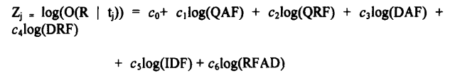
Probabilistic Weighting
Gey applied this methodology to the Cranfield Collection and additional attributes QRF, DRF, RFAD are included producing the following logodds formula:
Taking the logarithm of frequency data helps to reduce the impact of very high frequencies, leading to a more balanced distribution.

Slide 26
Probabilistic Weighting
Ranking and Comparison with Other Methods:
  The logistic inference method is used to predict relevance and was tested against the SMART vector space model, which relies on traditional term frequency and inverse document frequency.
  The logistic method showed better performance than the vector method.
  Researchers have explored combining various probabilistic techniques to enhance accuracy.
    However, attempts to average log-odds from different methods have not consistently yielded better results, and in some cases, they performed worse.

Slide 27
Vector Weighting
One of the earliest information retrieval system that utilized statistical methods and a vector model to represent information is SMART system.
The semantics (essentially, what they mean or represent) of every item are represented as a vector by translating its content into a numerical format.
  Example:
    Let's say we have a document about "Petroleum Refineries in Mexico." We might identify the following important tokens related to the document:
    Tokens: Petroleum, Mexico, Oil, Taxes, Refineries, Shipping
    Vector Representation (Weighted Approach):
      If "Petroleum" is very important, "Mexico" is somewhat important, and "Refineries" is also important, the vector might look like this:
        Vector=[0.9,0.7,0,0,0.8,0]

Slide 28
Vector Weighting
A vector is essentially a list of numbers, each corresponding to a specific token. The position of each number in the vector is fixed and represents a particular token.
Example:
    Let's say we have a document about "Petroleum Refineries in Mexico." We might identify the following important tokens related to the document:
    Tokens: Petroleum, Mexico, Oil, Taxes, Refineries, Shipping
    Vector Representation (Binary Approach):
      Vector=[1,1,0,0,1,0]
      Here, the positions correspond to:
        Position 1: Petroleum (1 - present)
        Position 2: Mexico (1 - present)
        Position 3: Oil (0 - absent)
        Position 4: Taxes (0 - absent)
        Position 5: Refineries (1 - present)
        Position 6: Shipping (0 - absent)

Slide 29
Vector Weighting
There are two approaches to the domain of values in the vector: binary and weighted.
  Binary Approach: In this method, the values in the vector are either 0 or 1. A value of 1 indicates that a particular token exists in the document, while 0 indicates its absence. This is a simple way to represent whether terms are present.
  Weighted Approach: Instead of just indicating presence, this method assigns a positive real number to each token. This number reflects the importance or relevance of the token to the document’s overall meaning. Higher values indicate greater significance.

Slide 30
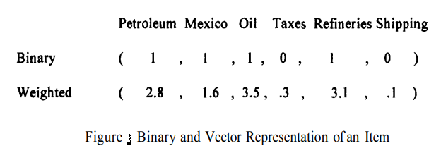
Vector Weighting
The following figure shows how an item that discusses petroleum refineries in Mexico would be represented .

Slide 31
Vector Weighting
Binary Vectors indicate the presence or absence of specific tokens (like words or phrases) related to the content of an item.
A decision process determines if a token is included based on its importance. For instance, in previous figure a five-page item may have had only one sentence like “Standard taxation of the shipment of the oil to refineries is enforced.”
  For the binary vector, the concepts of “Tax” and “Shipment” are below the threshold of importance (e.g., assume threshold is 1.0) and they not are included in the vector.

Slide 32
Vector Weighting
Unlike binary vectors, weighted vectors assign a range of values to tokens, reflecting their varying importance.
The use of weights also provides a basis for determining the rank of an item.
Vector Space Model allows for a mathematical representation of items in a multi-dimensional space, where each token adds another dimension.
Queries can also be represented as vectors in this same space, allowing for comparisons between the query and the items to determine relevance.

Slide 33
Vector Weighting
Document vectors can be enhanced by adding information such as citations or references to improve search and clustering capabilities.
However, these enhancements have not led to significant improvements in retrieval effectiveness.
When audio content (like broadcasts or conversations) is transcribed into text, the transcription process often introduces errors.
  For example, high-quality news transcriptions may still have about 15% word errors, while conversational speech can have 40% or more.
  These errors arise because audio transcription converts phonemes (sounds) into the closest matching words in a dictionary, leading to valid but incorrect word choices.

Slide 34
Vector Weighting
To address the issue:
  Take the text that has been transcribed (even if it has errors) and use it as a search query in an existing database (which contains more accurate and complete documents).
  Run the query against the database to find documents that are most similar or relevant to the transcribed text. These documents are ranked based on their relevance.
  Look at the highest-ranked results. These documents likely contain important words or phrases that are relevant to the topic but may have been missing from the original transcription.
  Select the most frequently occurring words from these top-ranked documents. These words are then added to the original transcribed document vector, effectively enriching it.

Slide 35
Vector Weighting
This technique can significantly reduce the effectiveness loss in retrieval, from 15-27% down to 7-13% when errors are around 40%. However, the benefits are less pronounced (marginal) when errors are around 15%.
Various algorithms can be employed to calculate the weights for processing tokens in a document.
A key aspect of information retrieval is adapting these algorithms to normalize data, accounting for variations in document lengths and word counts.

Slide 36
Vector Weighting
-- Simple Term Frequency Algorithm
Automatic Indexing involves using algorithms to evaluate and assign significance (weight) to words or tokens in a dataset, which can improve search and retrieval processes.
The weight of a token is determined by a number of factors, including:
  Term Frequency (TF): The number of times a token appears in a specific document.
  Total Frequency (TOTF): The total occurrences of the token across all documents in the database.
  Item Frequency (IF) or Document Frequency (DF): The number of documents that contain the token at least once.

Slide 37
Simple Term Frequency Algorithm
According to Luhn and Brookstein’s Premise the importance of a word in a document is directly linked to how often it appears. Therefore, most automatic weighting methods are based on this concept.
These typically assign positive values to weight.
  For example, if "computer" appears 15 times in a document, its weight would be 15.
One problem with simply using term frequency is that longer documents might naturally have higher counts for any token, leading to biased results.
  This means that longer documents could skew the perceived importance of certain tokens.

Slide 38

Simple Term Frequency Algorithm
To address this, normalization techniques are often applied.
These adjust the term frequency , ensuring fairer comparisons across documents of varying lengths more equitable.
The term frequency weighting formula used in TREC 4 was:
  where slope was set at .2 and the pivot was set to the average number of unique terms occurring in the collection.

Slide 39
Simple Term Frequency Algorithm
In addition to compensating for document length, the formula should be insensitive to anomalies introduced by stemming or misspellings.
The SMART system, using the TREC database, found that a simpler algorithm (with proper normalization) is more efficient in processing queries and returning relevant results, even when compared to more complex algorithms.

Slide 40
Simple Term Frequency Algorithm
When choosing the appropriate value for Term Frequency, there are numerous methods to take various document lengths into consideration.
Term Frequency Normalization:
  Maximum Term Frequency: In this approach the term frequency for each word is divided by the maximum frequency of the word in any item.
    This scales the values between 0 and 1, but in short documents, this method might reduce the term frequency too much, making it lose significance.
  Logarithmic Term Frequency: Instead of using raw term frequencies, this technique applies the logarithm of the term frequency plus a constant, which helps adjust term frequency values, especially when document sizes vary greatly. It smooths the effect of very large or very small term frequencies.

Slide 41
Simple Term Frequency Algorithm
Cosine Similarity and Vector Normalization:
  The Cosine similarity measure treats the document’s term frequencies as a vector, then normalizes all the term frequencies by dividing them by the vector's length.
  This results in a vector with a maximum length of 1.
  The problem occurs when there are multiple topics within an item.
    The COSINE technique will normalize all values based upon the total length of the vector that represents all of topics. If a particular topic is important but briefly discussed, its normalized value could significantly reduce its overall importance in comparison to another document that only discusses the topic.

Slide 42
Simple Term Frequency Algorithm
Singhal did experiments that showed longer documents in general are more likely to be relevant to topics then short documents but normalization makes them appear equal in length to shorter documents.
Singhal suggested a correction factor for this bias.
  This correction uses a "pivot point“, where the relevance of longer documents is balanced with the probability of their retrieval, adjusting the normalization

Slide 43
Simple Term Frequency Algorithm
The pivot point is where the old normalization function and the new one intersect. This point represents the threshold at which the old and new normalization methods yield the same result.
Beyond this point, the slope of the line changes, reflecting different behavior for documents longer than the pivot point.
The theory is based upon straight lines so it is a matter of determining slope of the lines.
  New normalization = (slope) * (old normalization) + K

Slide 44
Simple Term Frequency Algorithm
K is generated by the rotation of the pivot point to generate the new line and the old normalization = the new normalization at that point.
By substituting the pivot value into both the old and new formulas, the correction factor K is determined.
Once K is known, it is substituted back into above formula (New normalization = (slope) * (old normalization) + K ) produces the following formula:
  Pivoted function = (slope) * (old normalization) + (1.0 – slope) * (pivot)
  Slope and pivot are constants for any document/query set

Slide 45
Simple Term Frequency Algorithm
Cosine function favors short documents over long documents and also favors documents with a large number of terms.
If log(TF) is used instead of the normal frequency then TF is not a significant factor.
  (1 + log(TF))/(1 + log(average(TF))
This leads to the final algorithm that weights each term by the above formula divided by the pivoted normalization:
  ((1 + log(TF))/(1 + log(average(TF))/(slope)(No. unique terms) + (1 – slope)*(pivot)

Slide 46

Vector Weighting
-- Inverse Document Frequency

